Slide 1


Mohr’s Circle Using Matlab GUI Group No. : 14
Ahmed Ashraf
Ahmed Saad
Mohamed Abdelraof

Slide 2
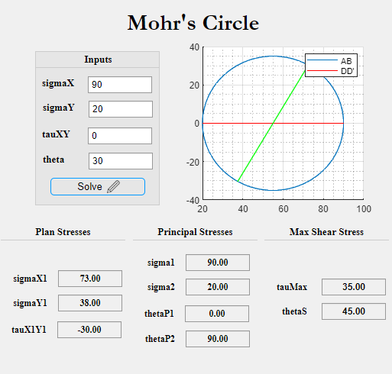
Example 7-4

Slide 3
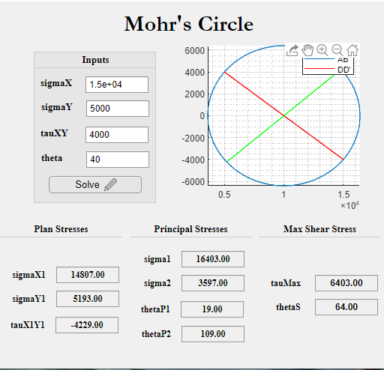
Example 7-5

Slide 4
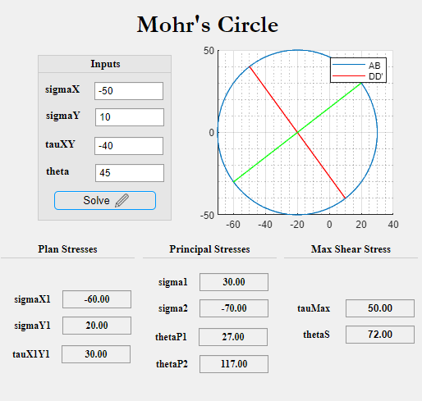
Example 7-6

Slide 5
Thanks

